Slide 1

Mini project Presentation SESSION 2021-22
Department of Computer Science and Engineering
ABES Engineering College, Ghaziabad, UP
SHIVAM TYAGI 1900320100151 2019B101078
Team Name :GOOD WAY (SHIVAM TYAGI)
Class & Section :CSE-C
Member Name University Roll No Admission No

Slide 2


PROJECT TITLE:
NETFLIX DATA ANALYSIS

Slide 3
Project description
I had create this project to know the content quality of the NETFLIX, that how much content on it and belong to which country, also know the change in content during COVID-19 pandemic. I have get the dataset from Kaggle, the name of that dataset is netflix_title.csv.

Slide 4
Project flow:
1.Finding Missing Values from dataset.
2.Handling missing data Analysis.
3.Which countries have the highest number of movies and tv shows
4. Solve for countries with the highest numbers of movies alone
Content added over the years .
5. Calculating the change in content addition during
Covid-19 pandemic.
6. Movie Content?
7. TV Content

Slide 5









Technology used:

Slide 6
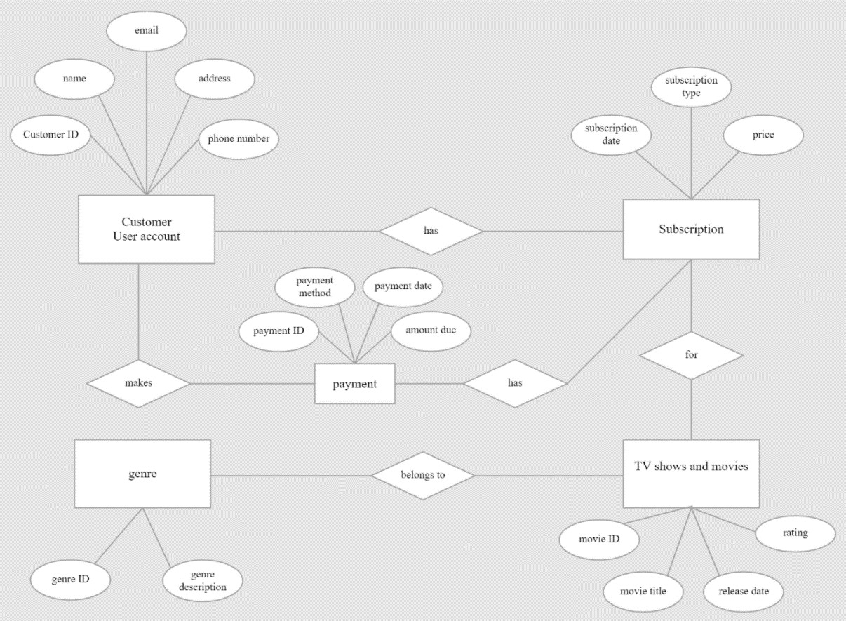
Er diagram

Slide 7
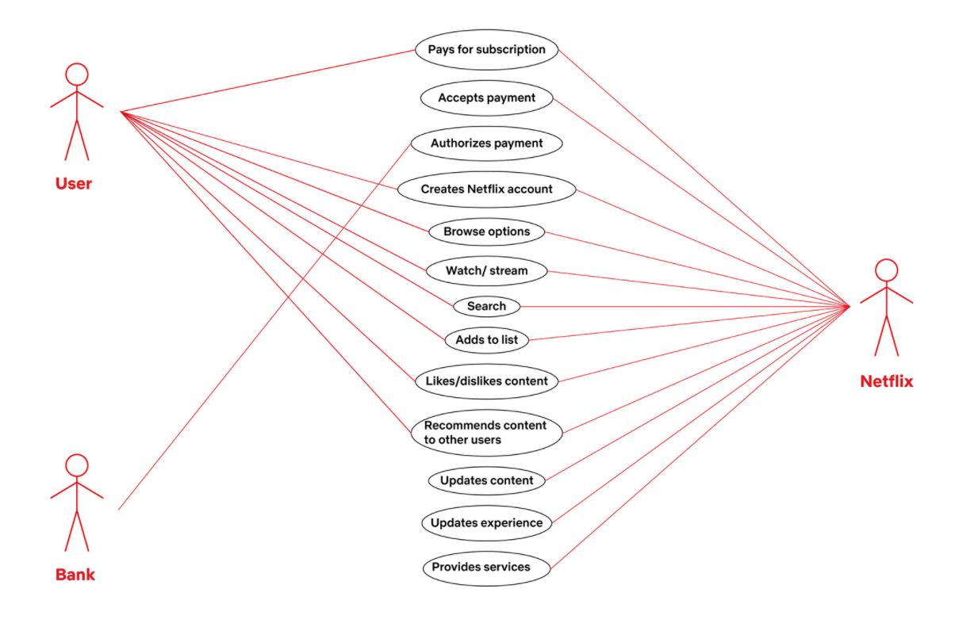
Use case diagram

Slide 8
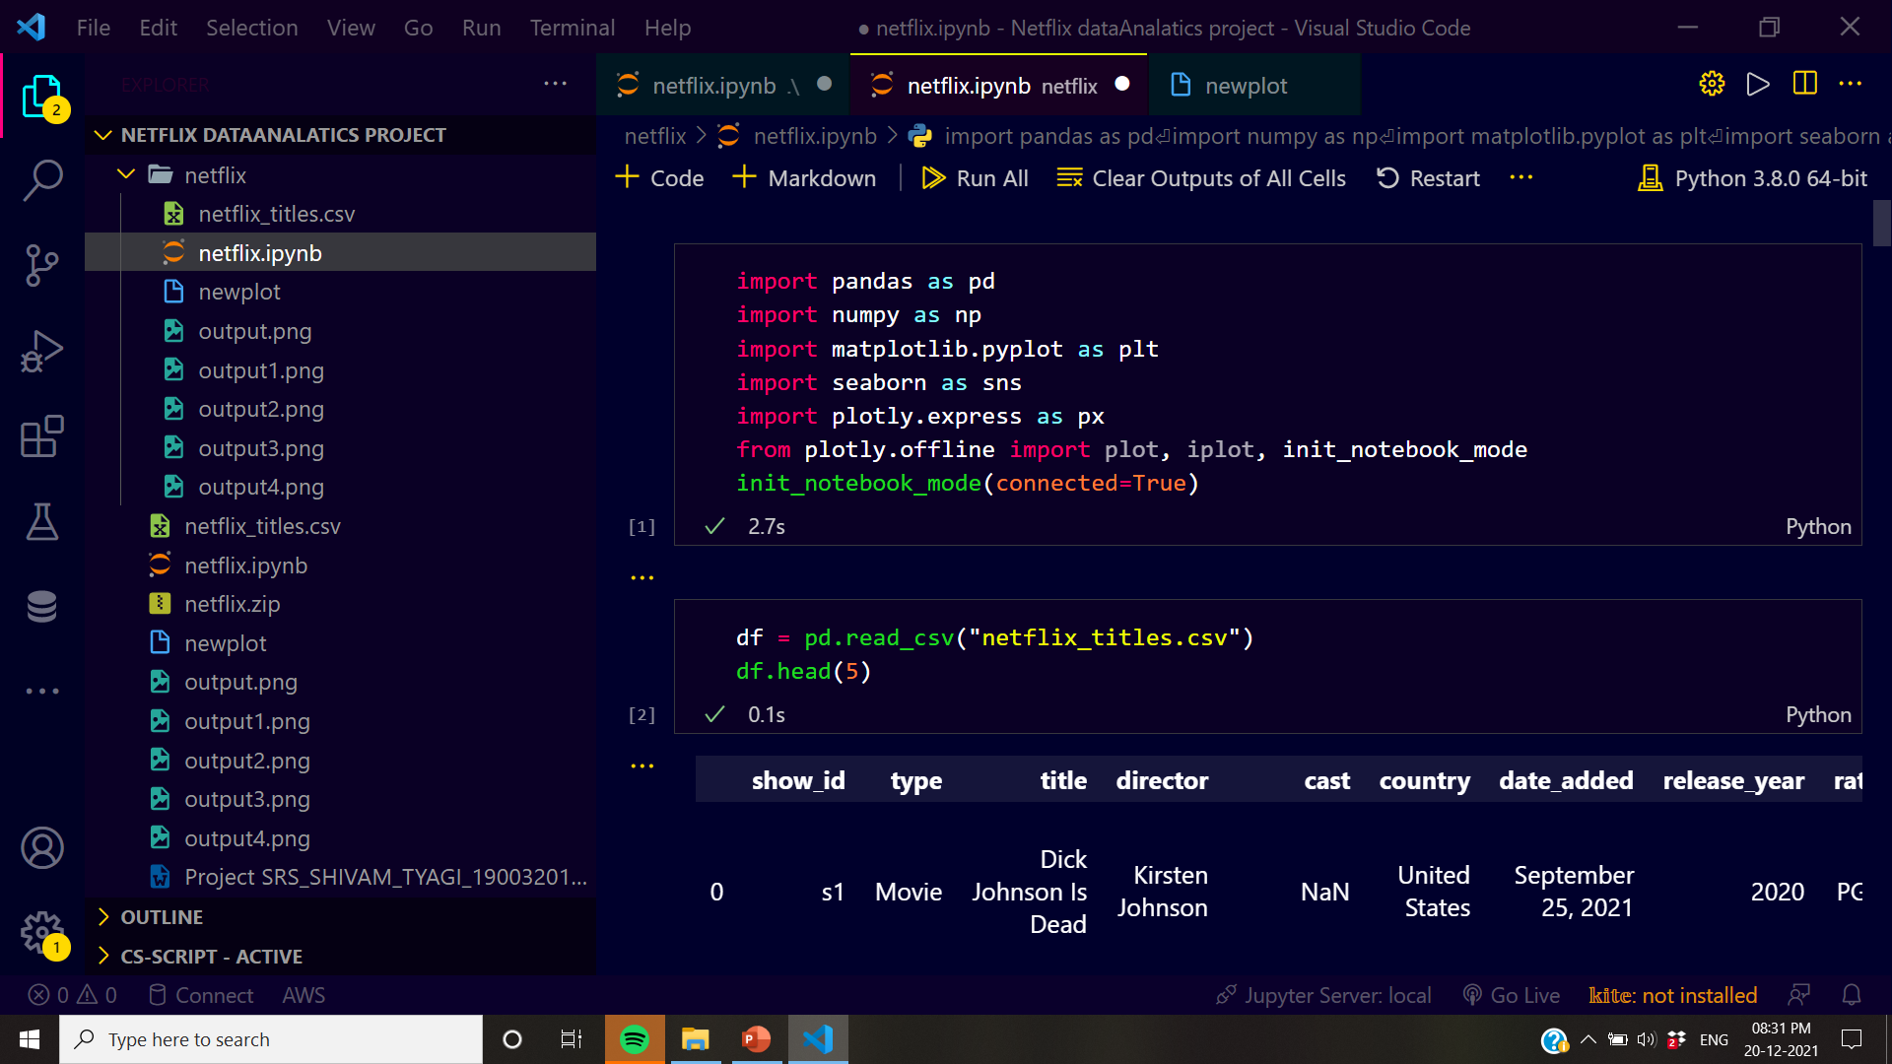
Screens

Slide 9
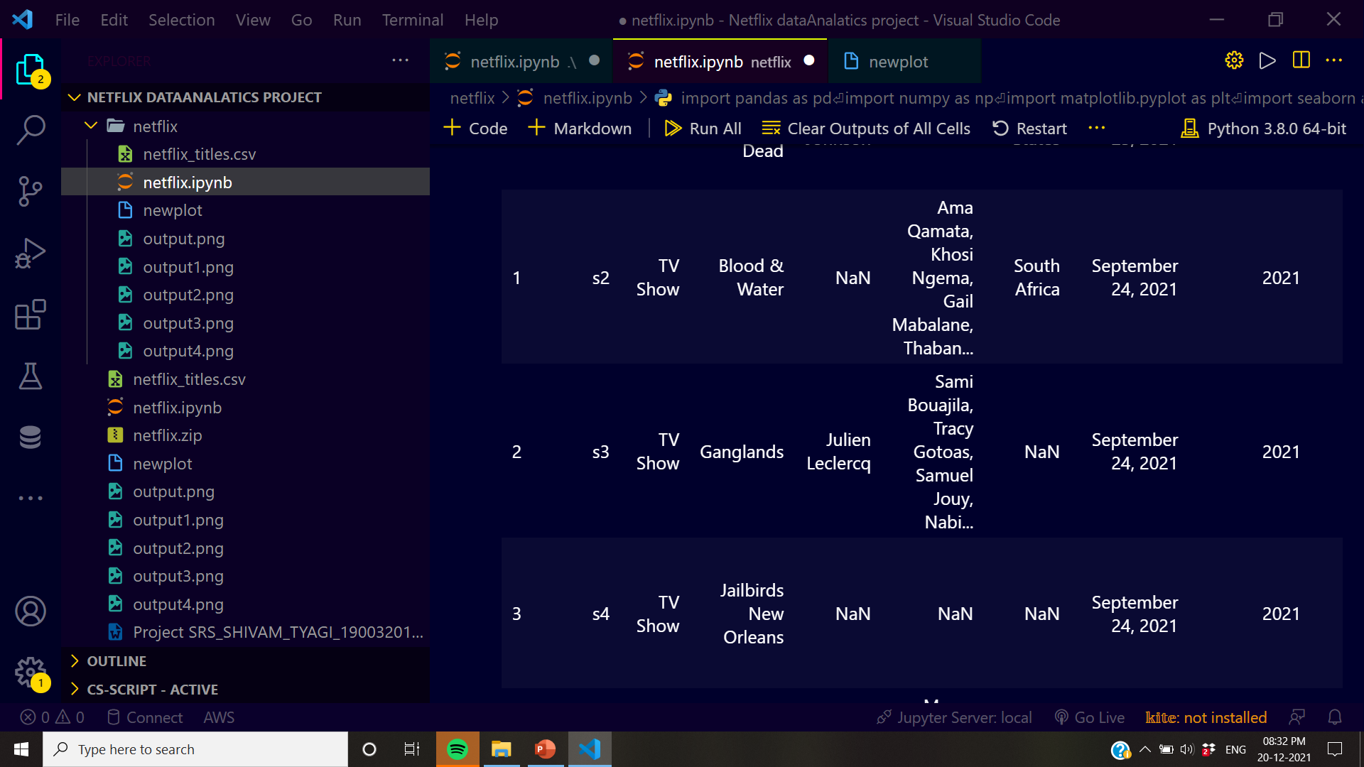
Screen:2

Slide 10
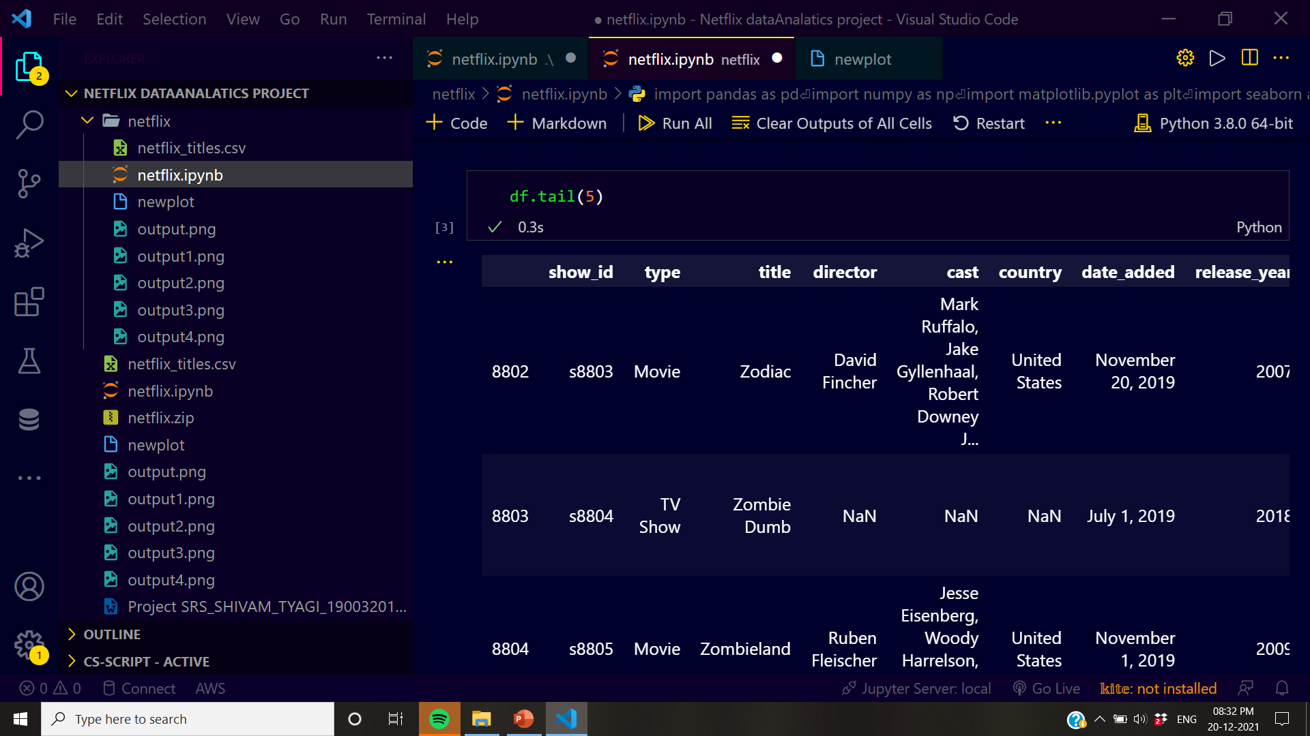
Screen:3

Slide 11
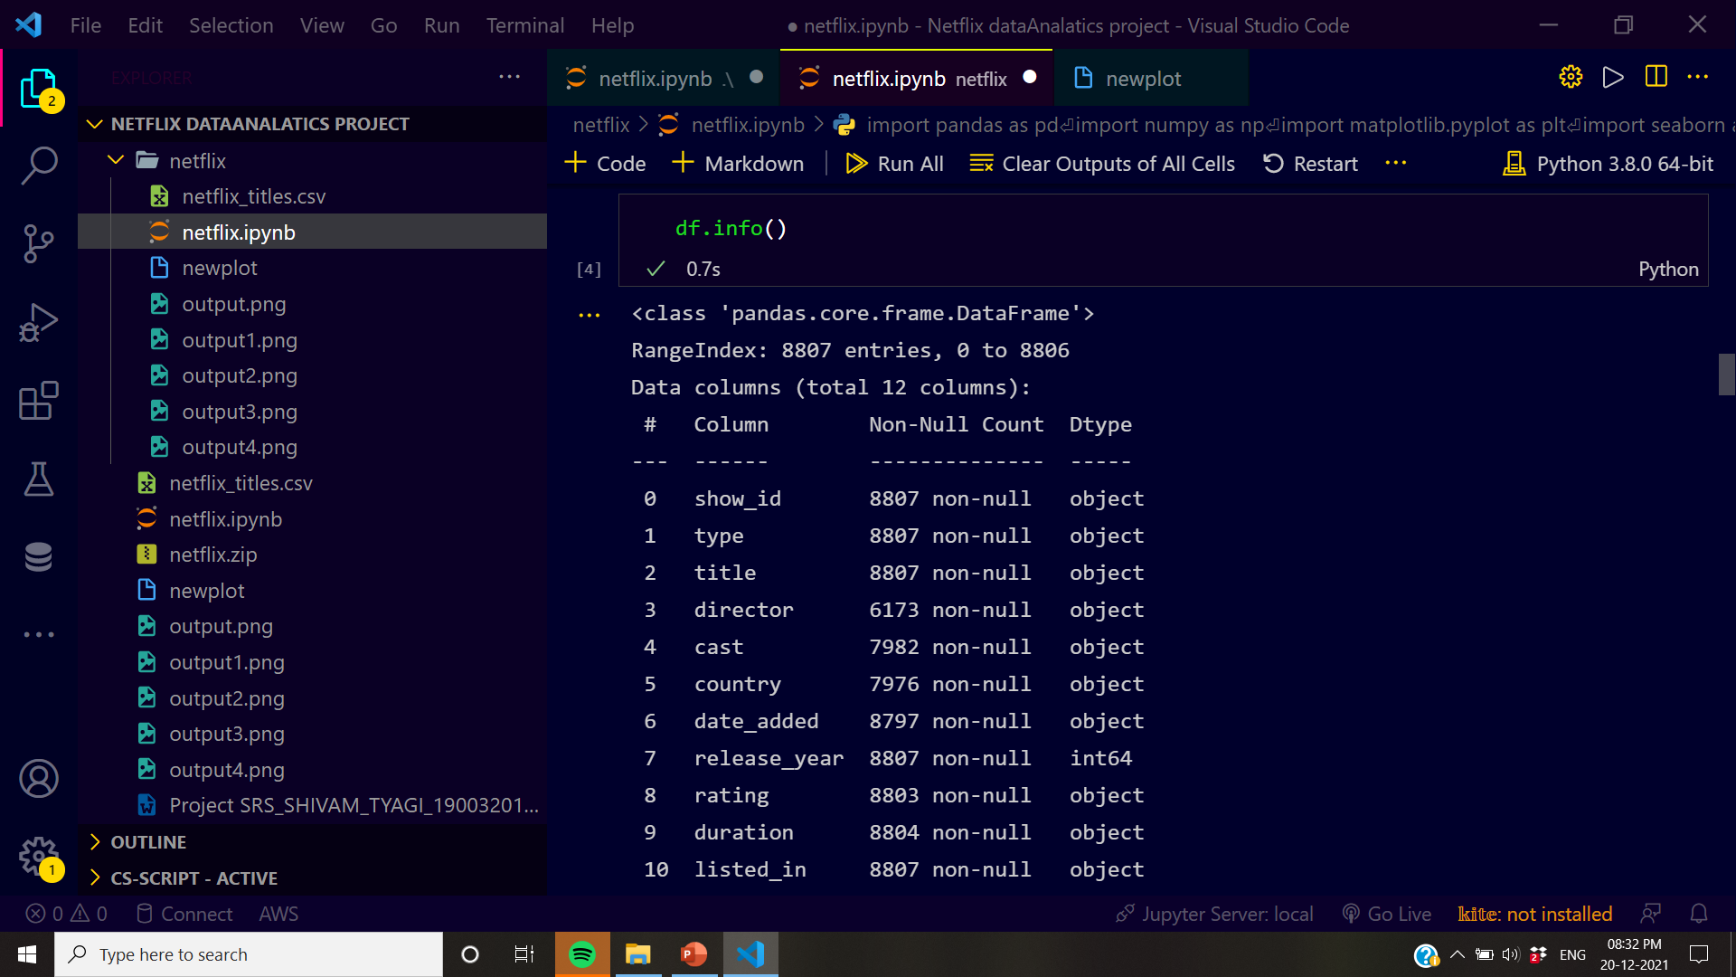
Screen:4

Slide 12
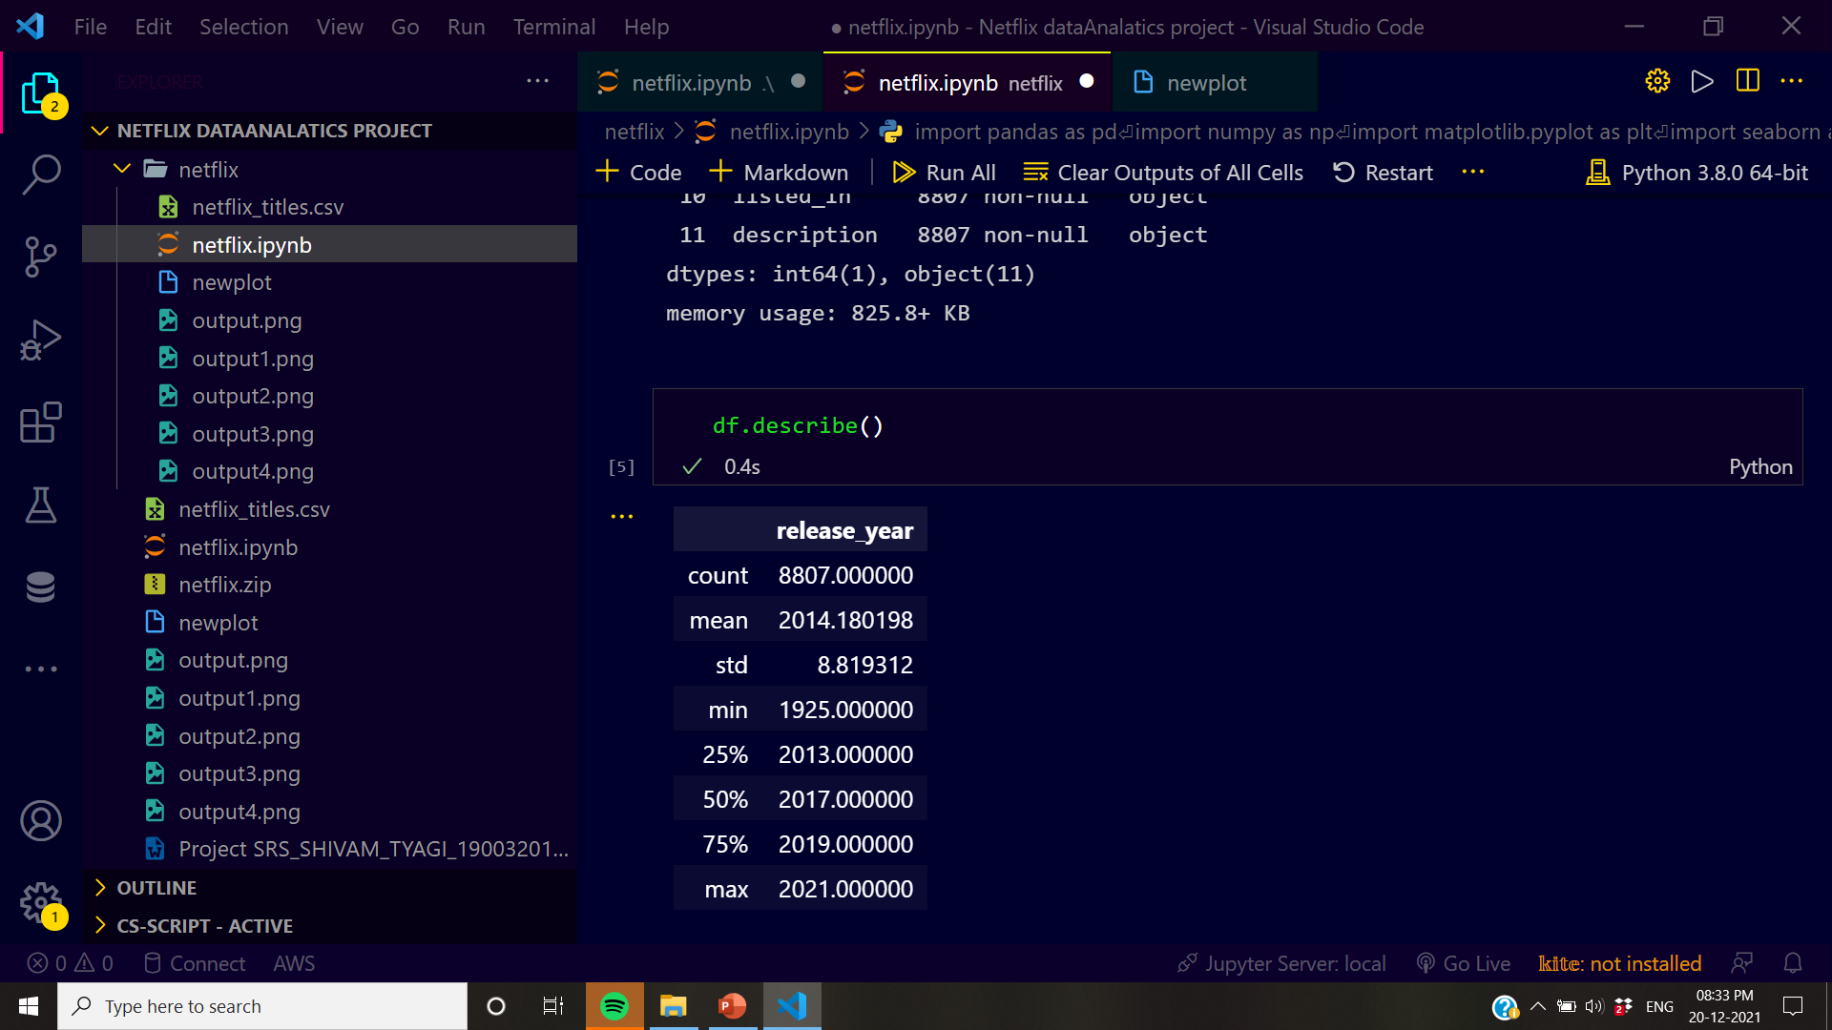
Screen:5

Slide 13
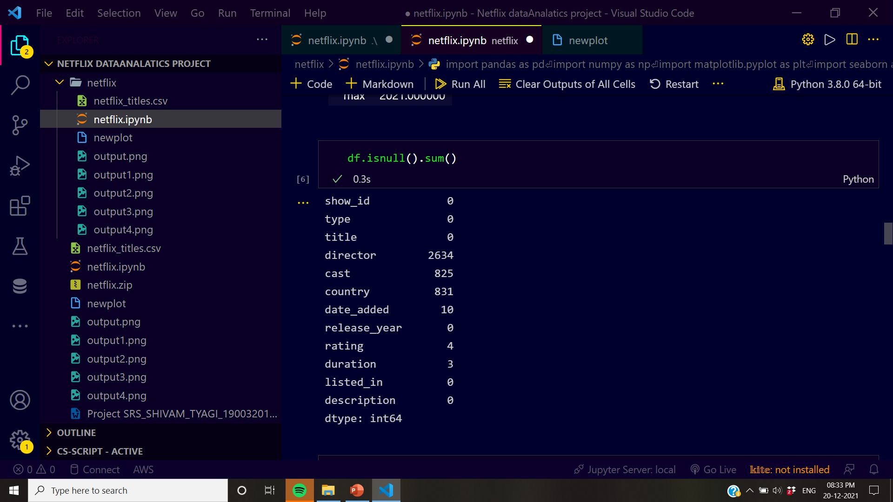
Screen:6

Slide 14
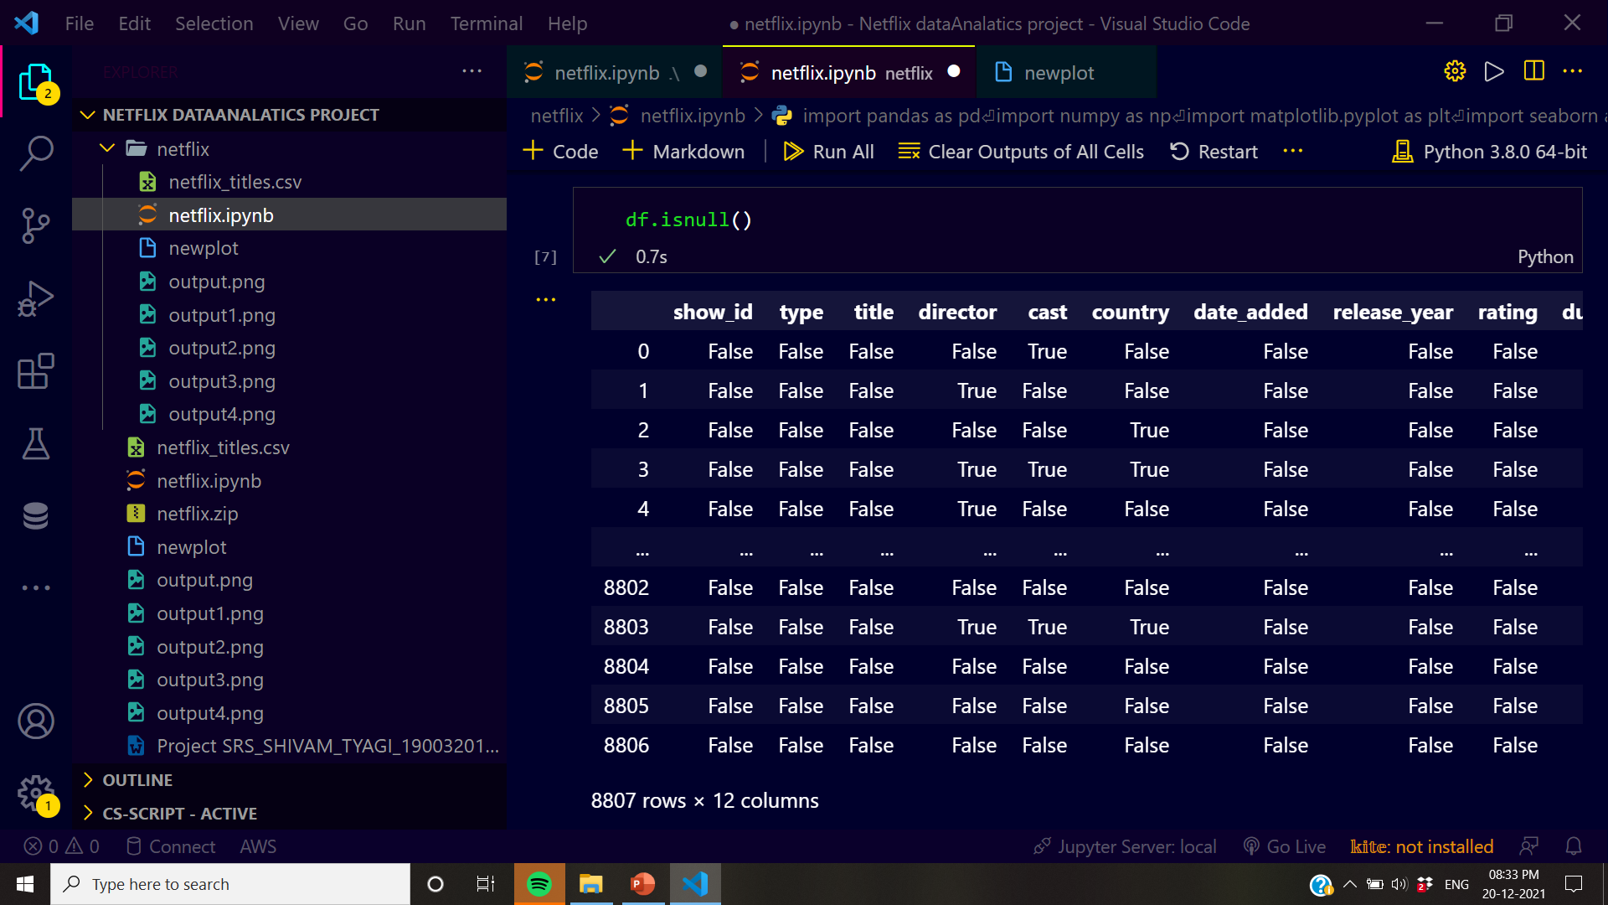
Screen:7

Slide 15
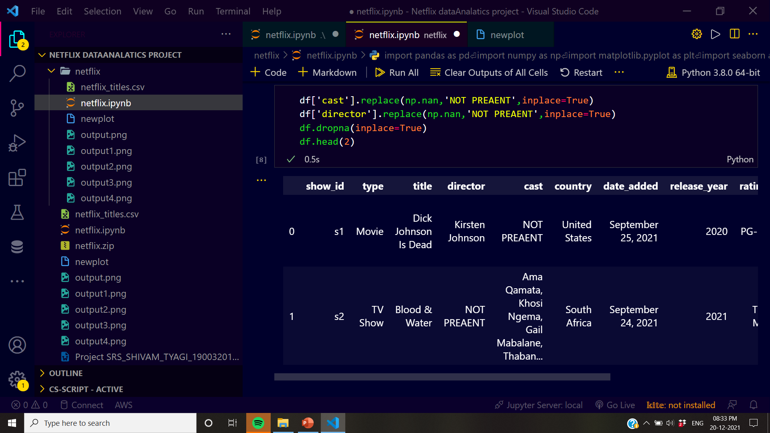
Screen:8

Slide 16
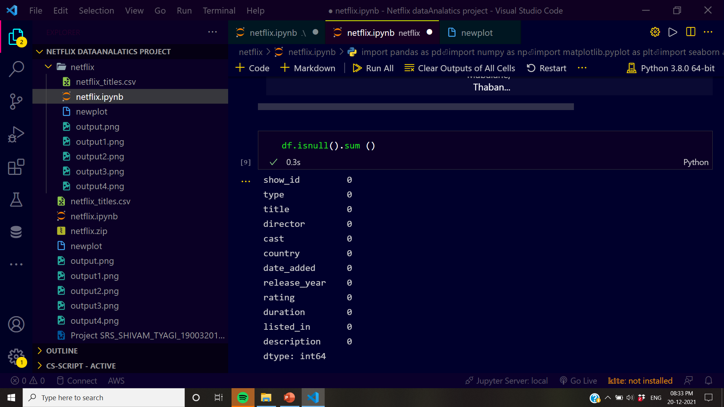
Screen:9

Slide 17
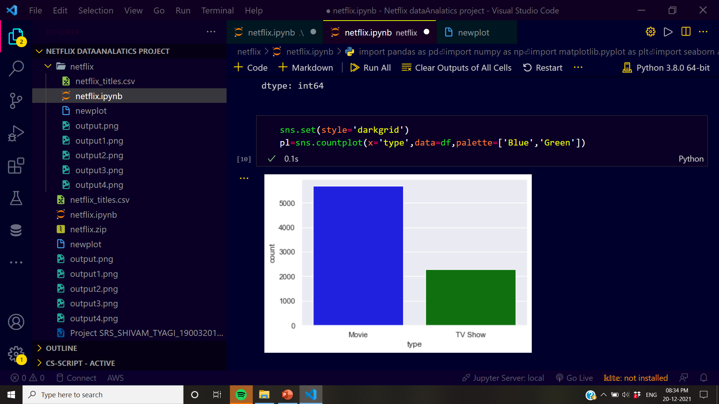
Screen:10

Slide 18
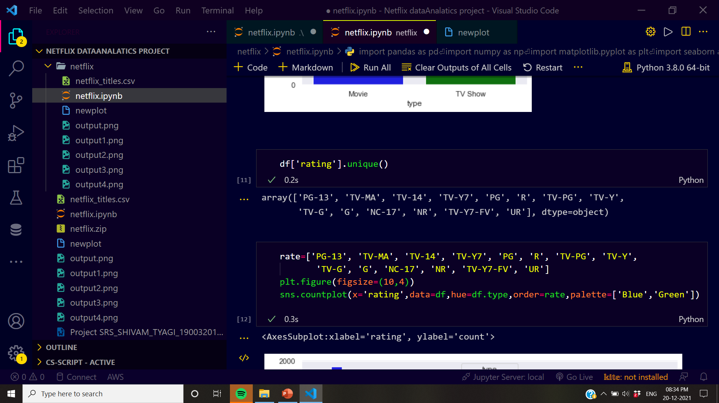
Screen:11

Slide 19
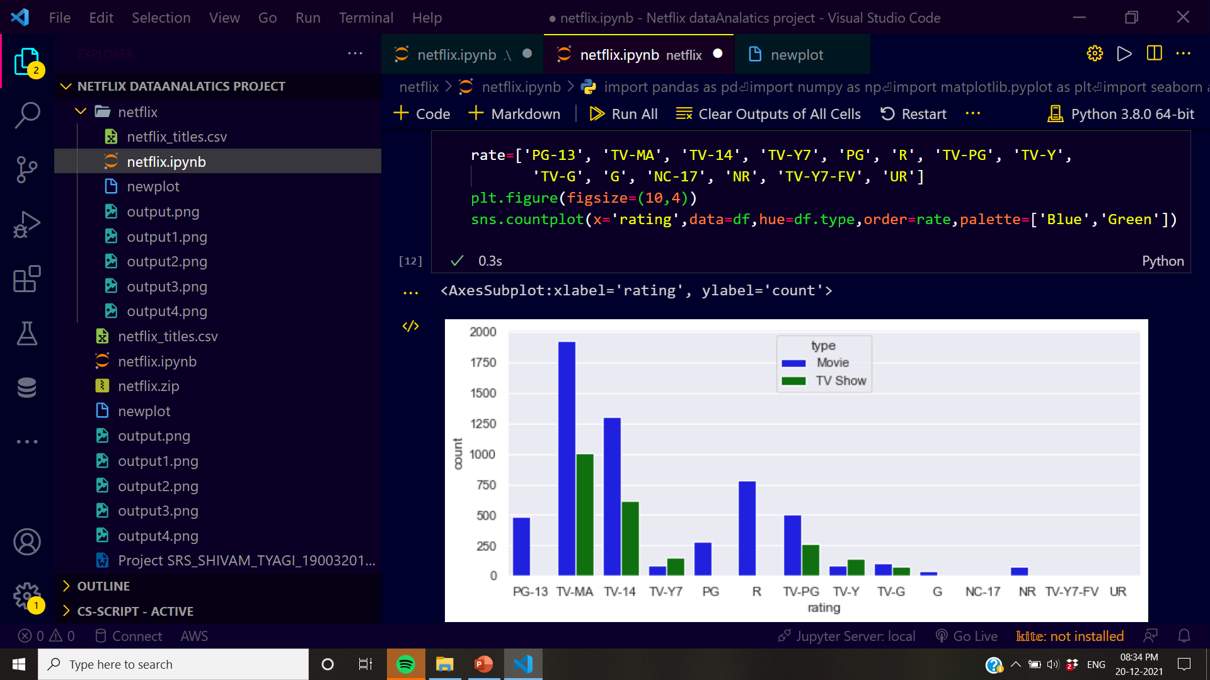
Screen:12

Slide 20
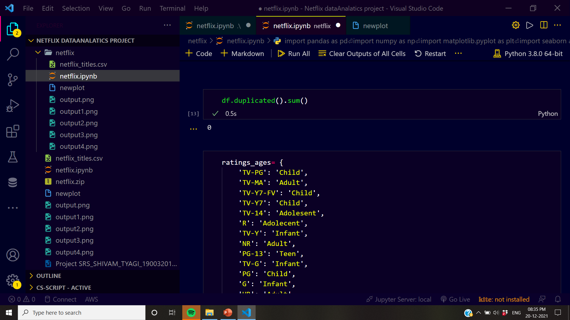
Screen:13

Slide 21
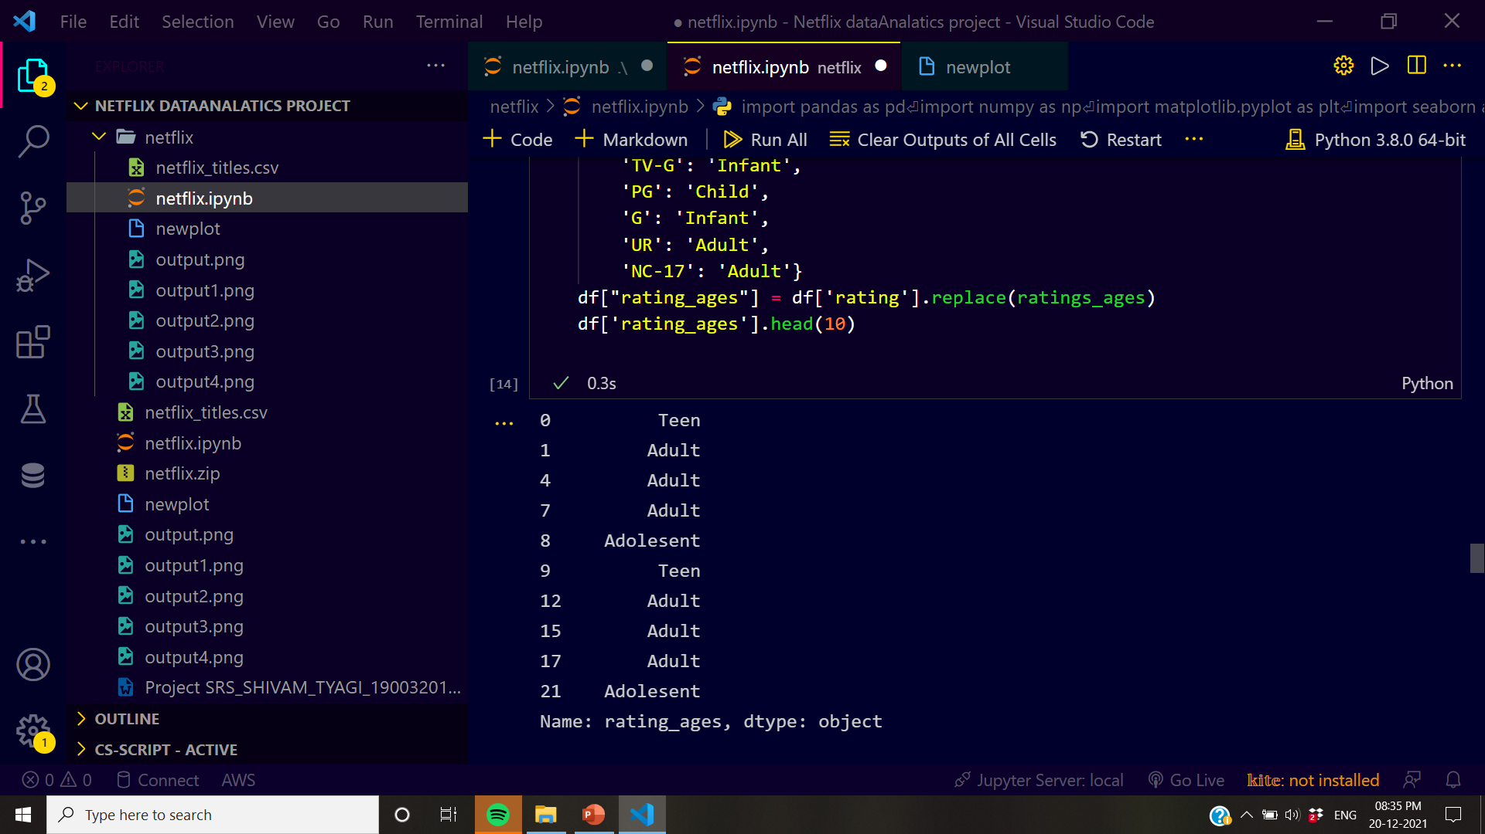
Screen.14

Slide 22
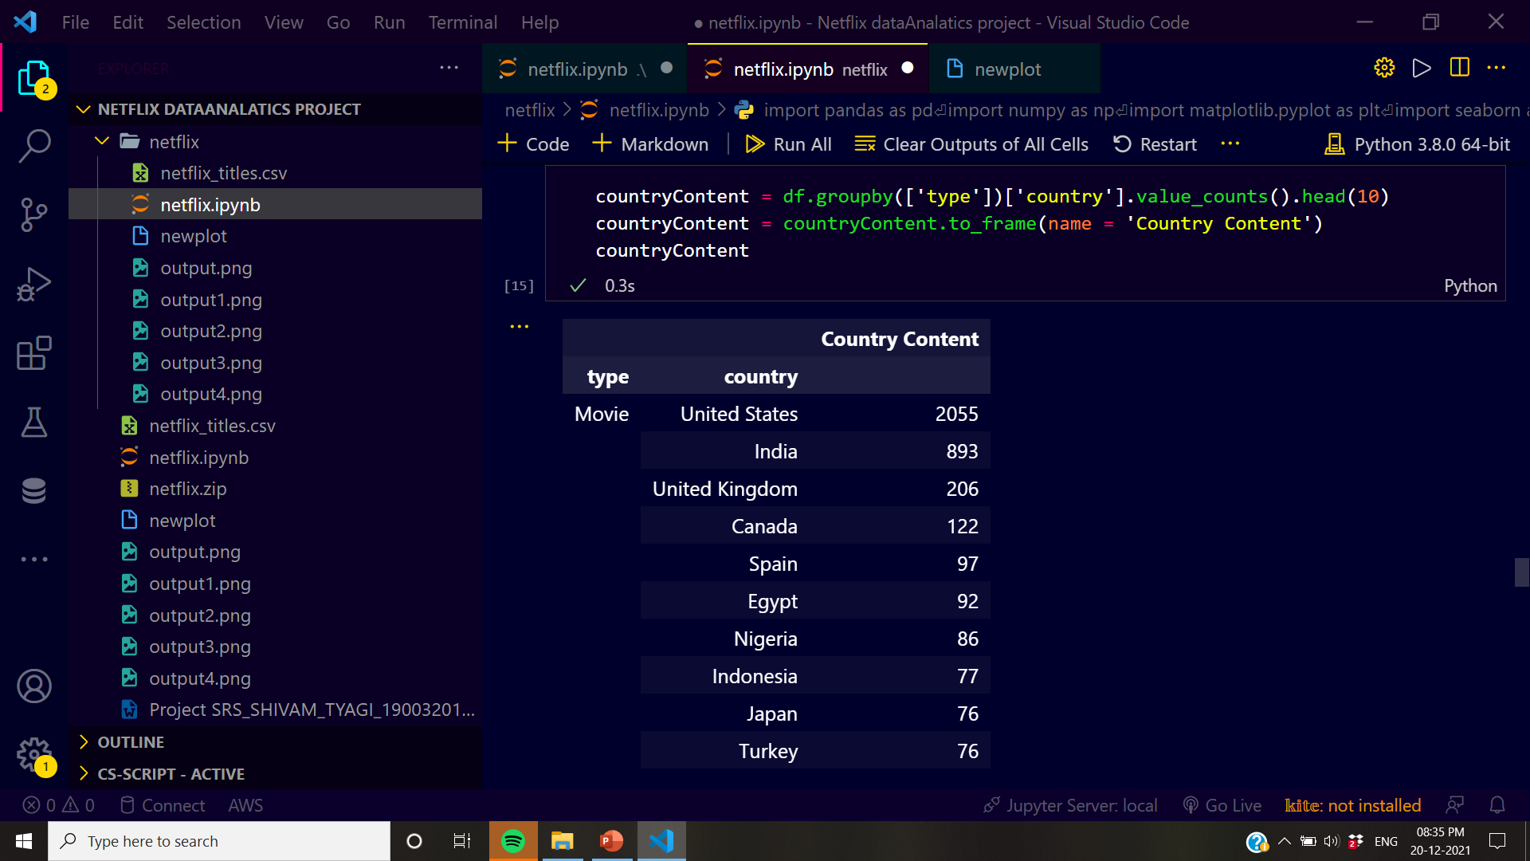
Screen.15

Slide 23
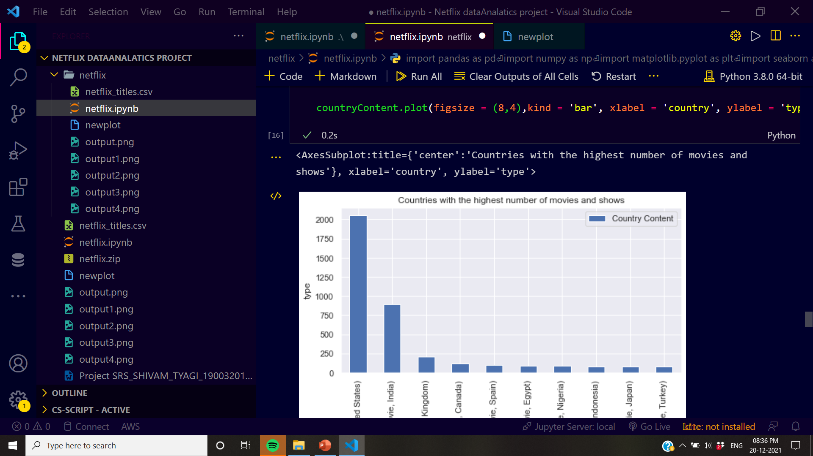
Screen.17

Slide 24
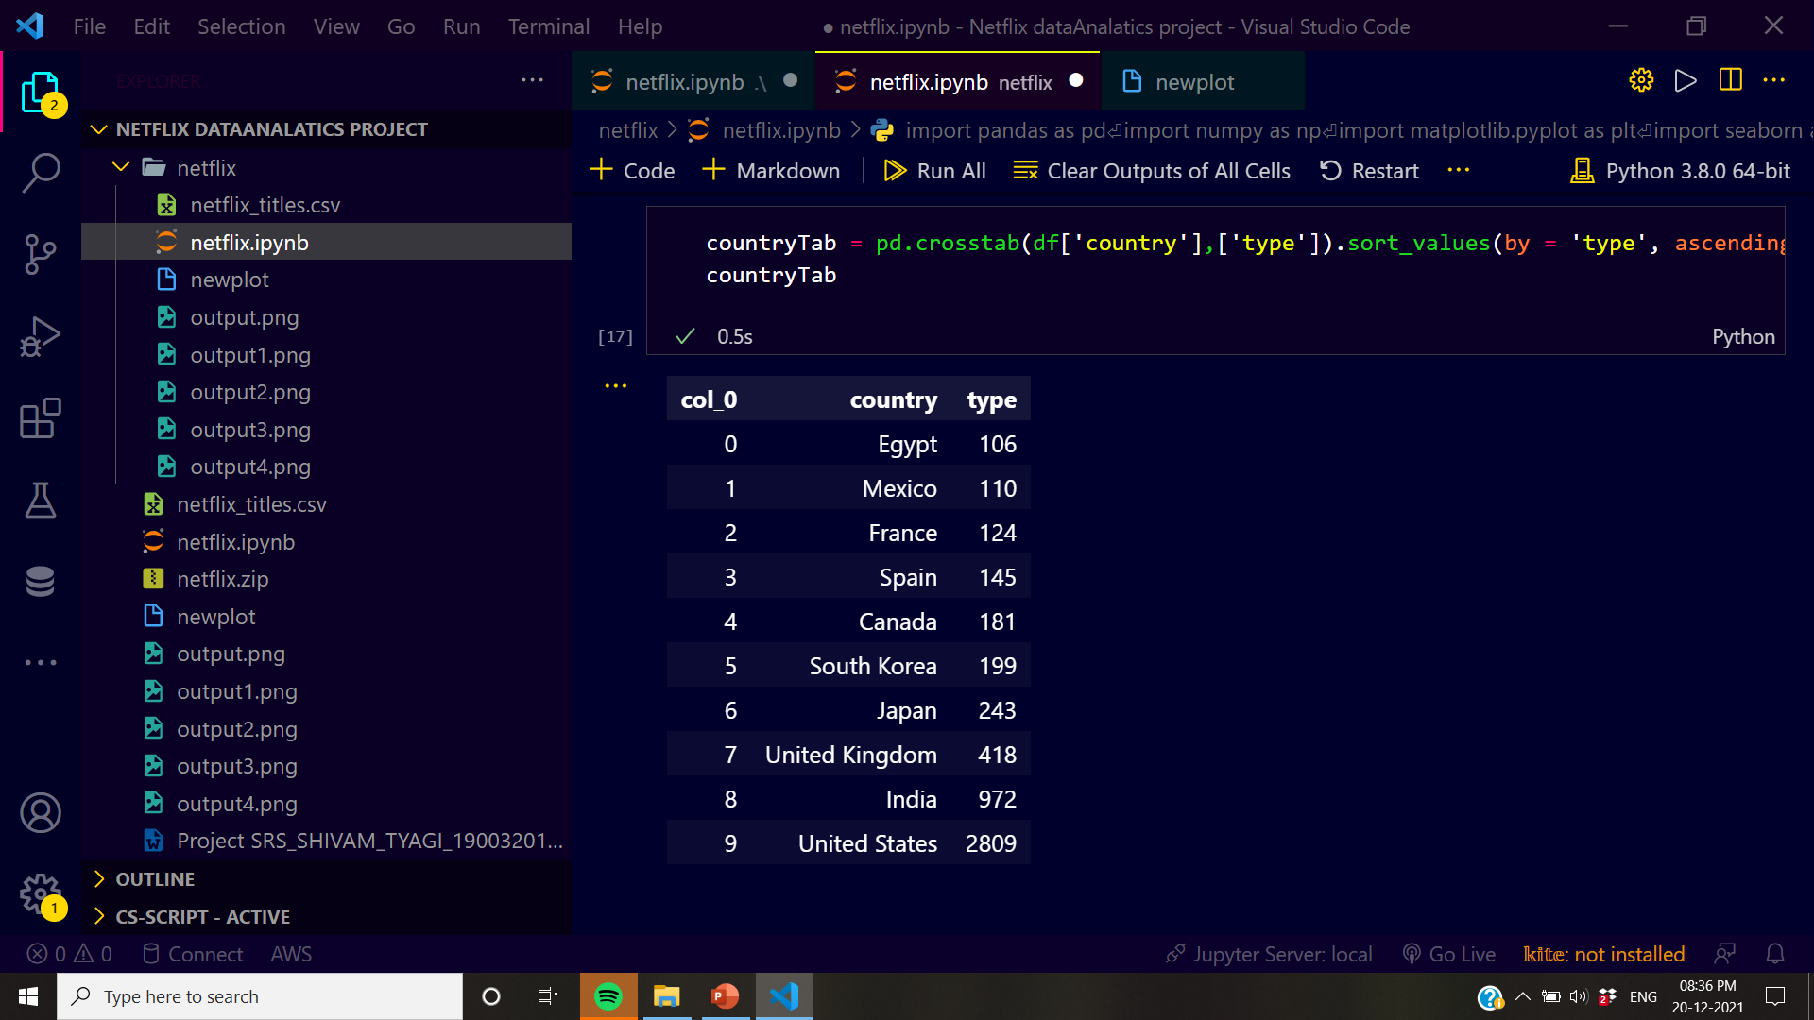
Screen.18

Slide 25
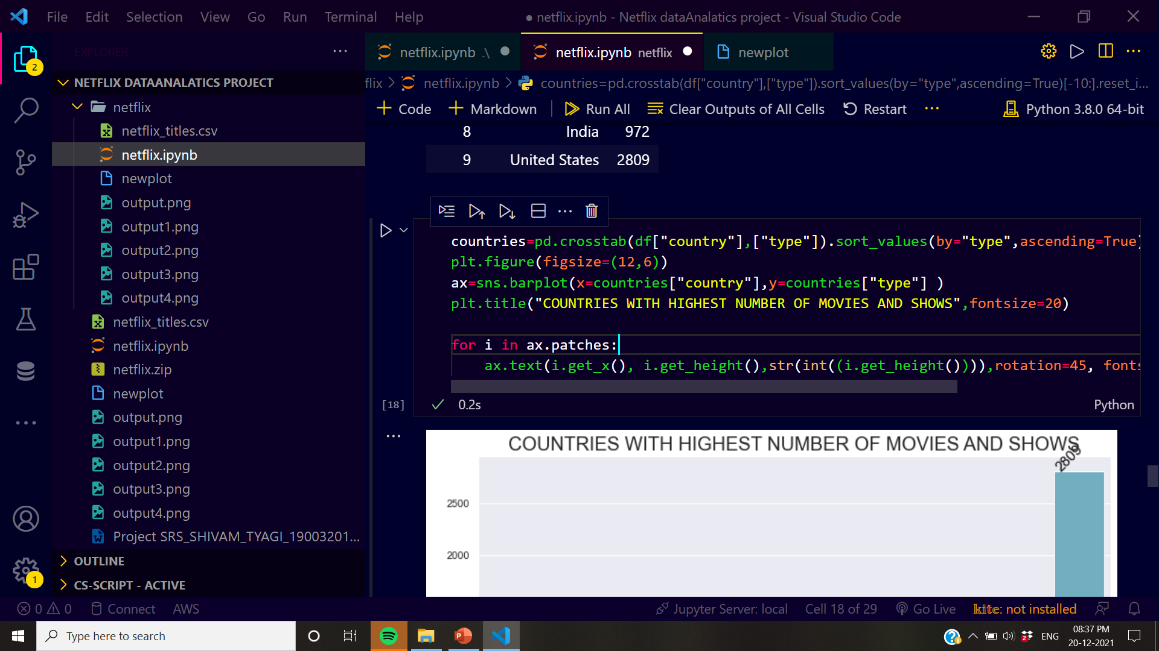
Screen.19

Slide 26
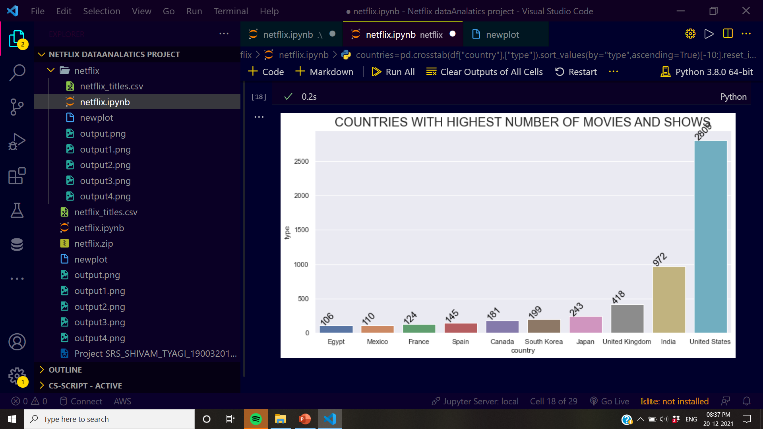
Screen.20

Slide 27
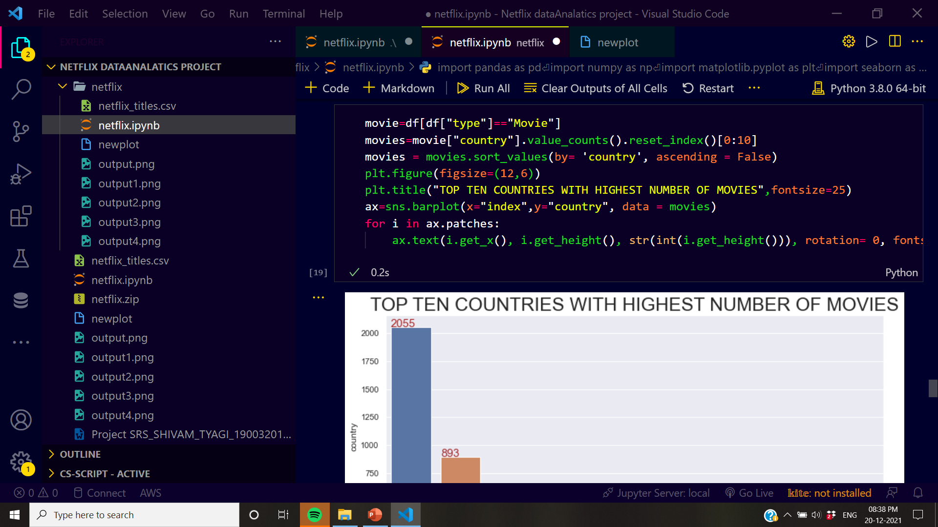
Screen.21

Slide 28
Screen.22

Slide 29
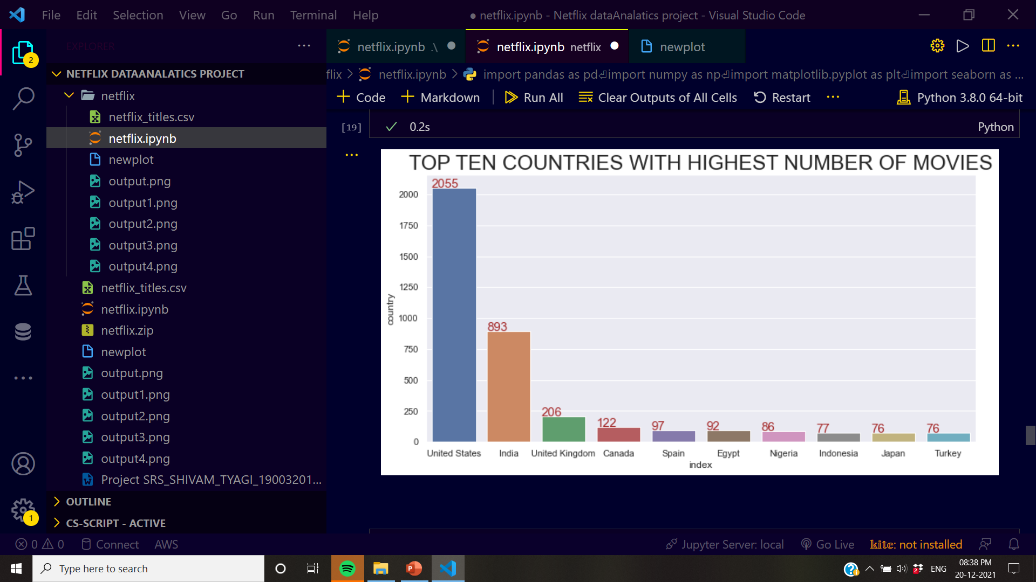
Screen.23

Slide 30
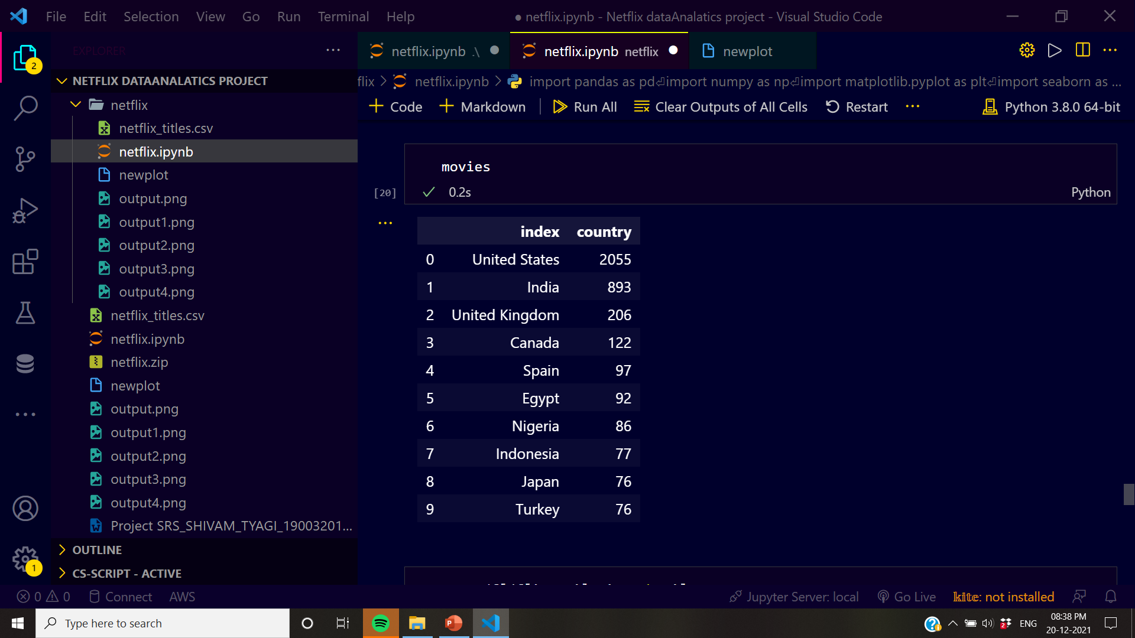
Screen.24

Slide 31
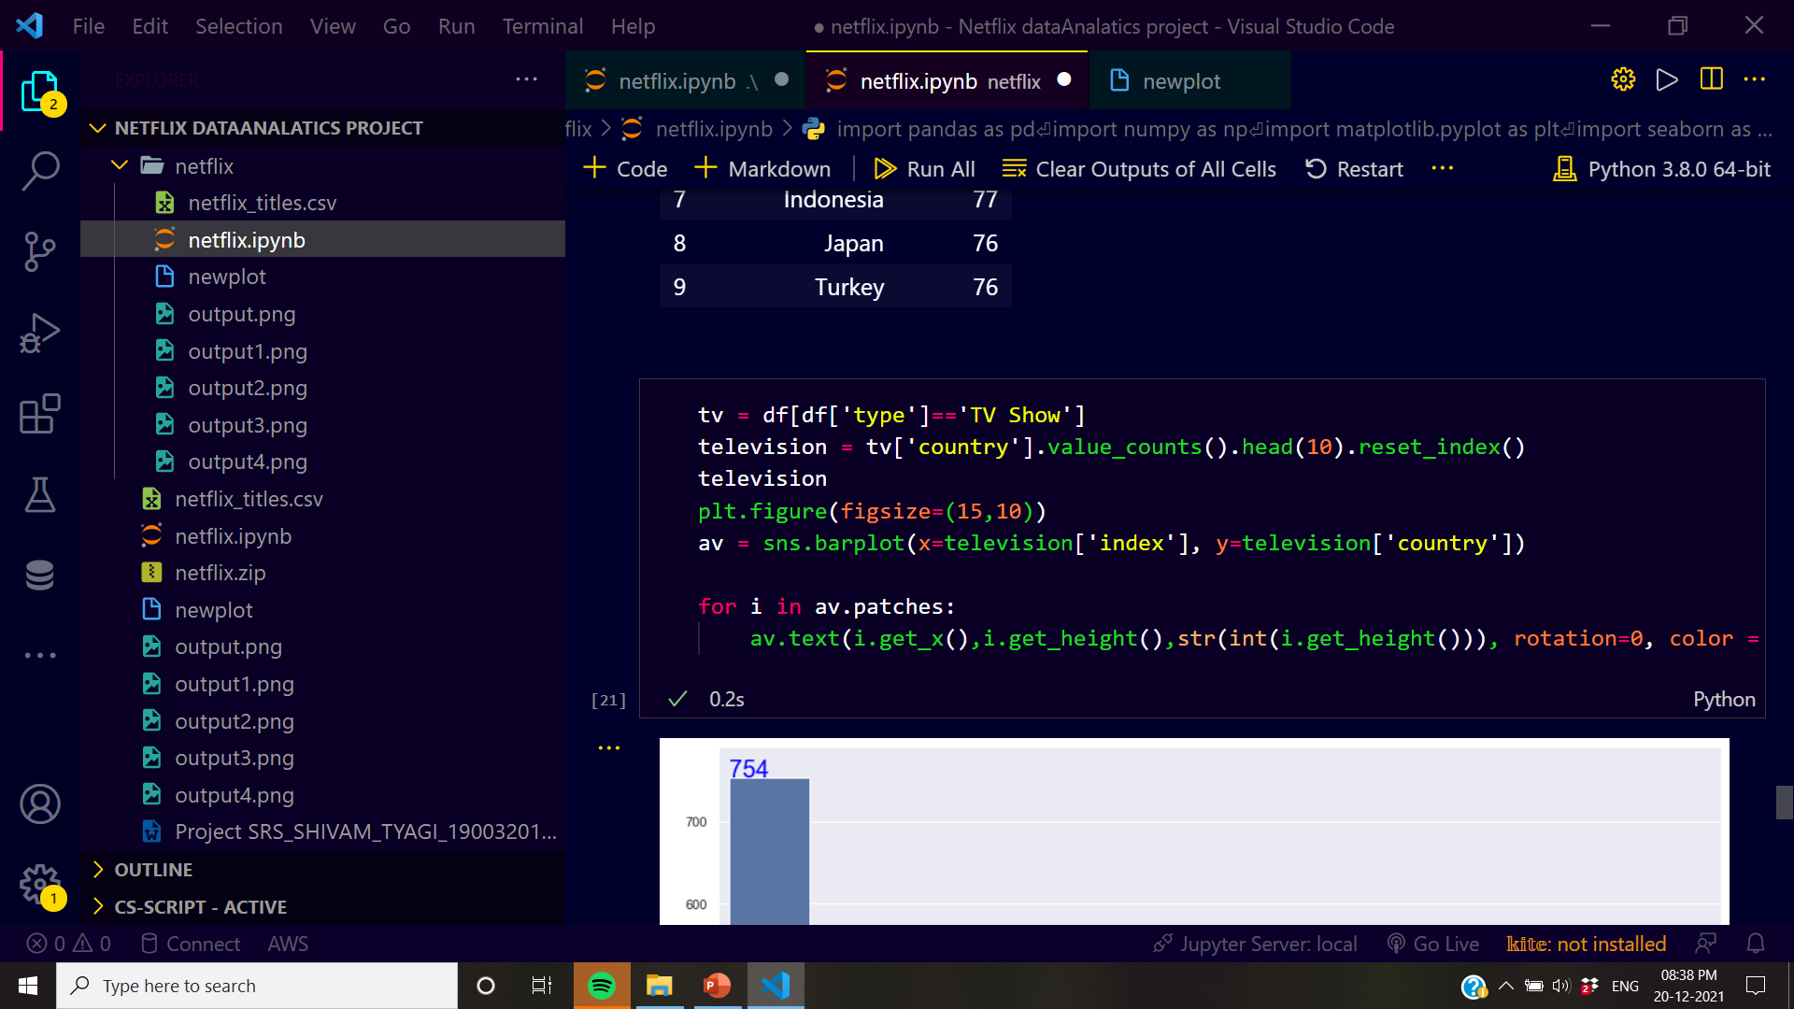
Screen.25

Slide 32
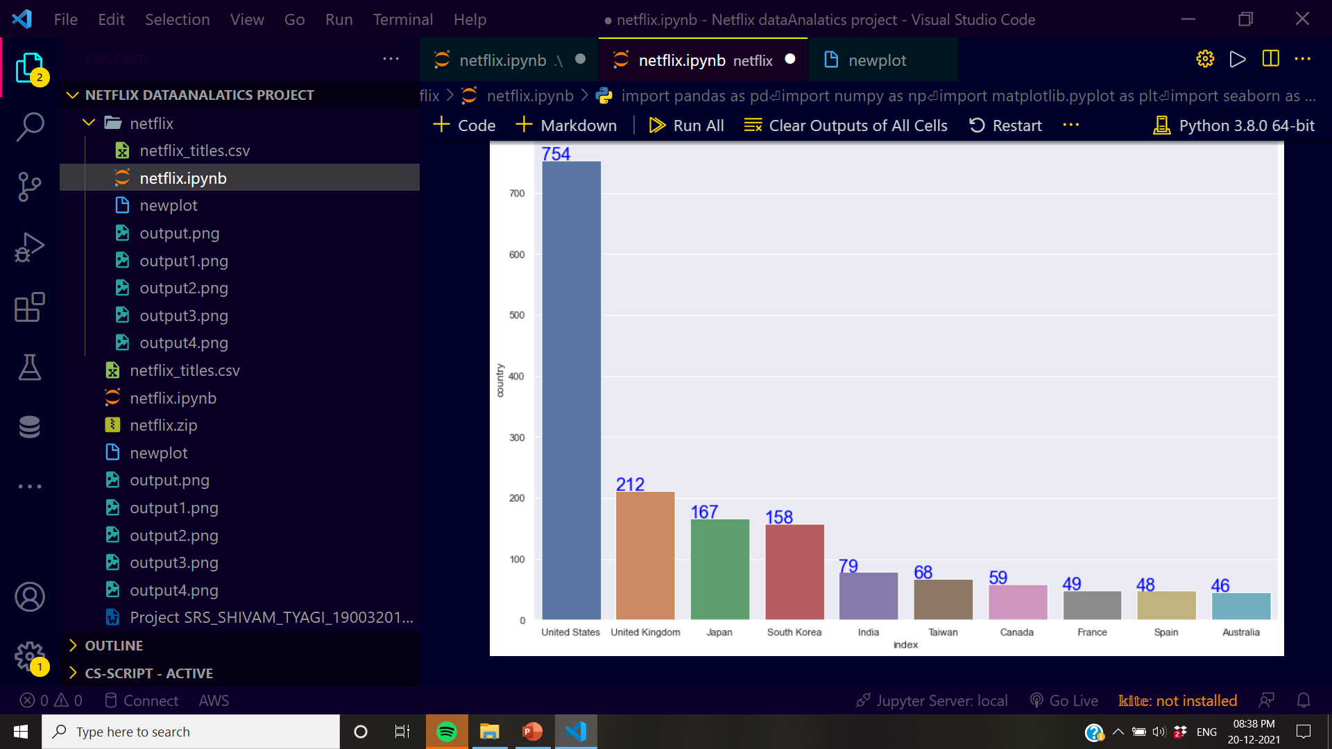
Screen.26

Slide 33
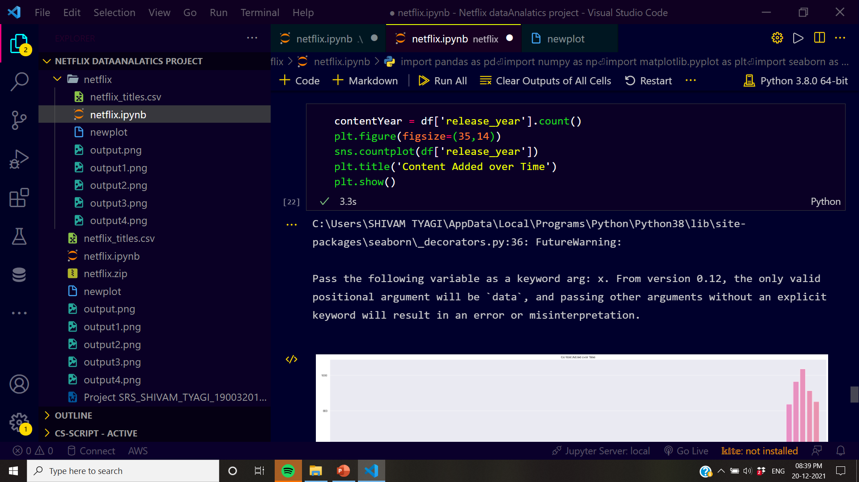
Screen.26

Slide 34
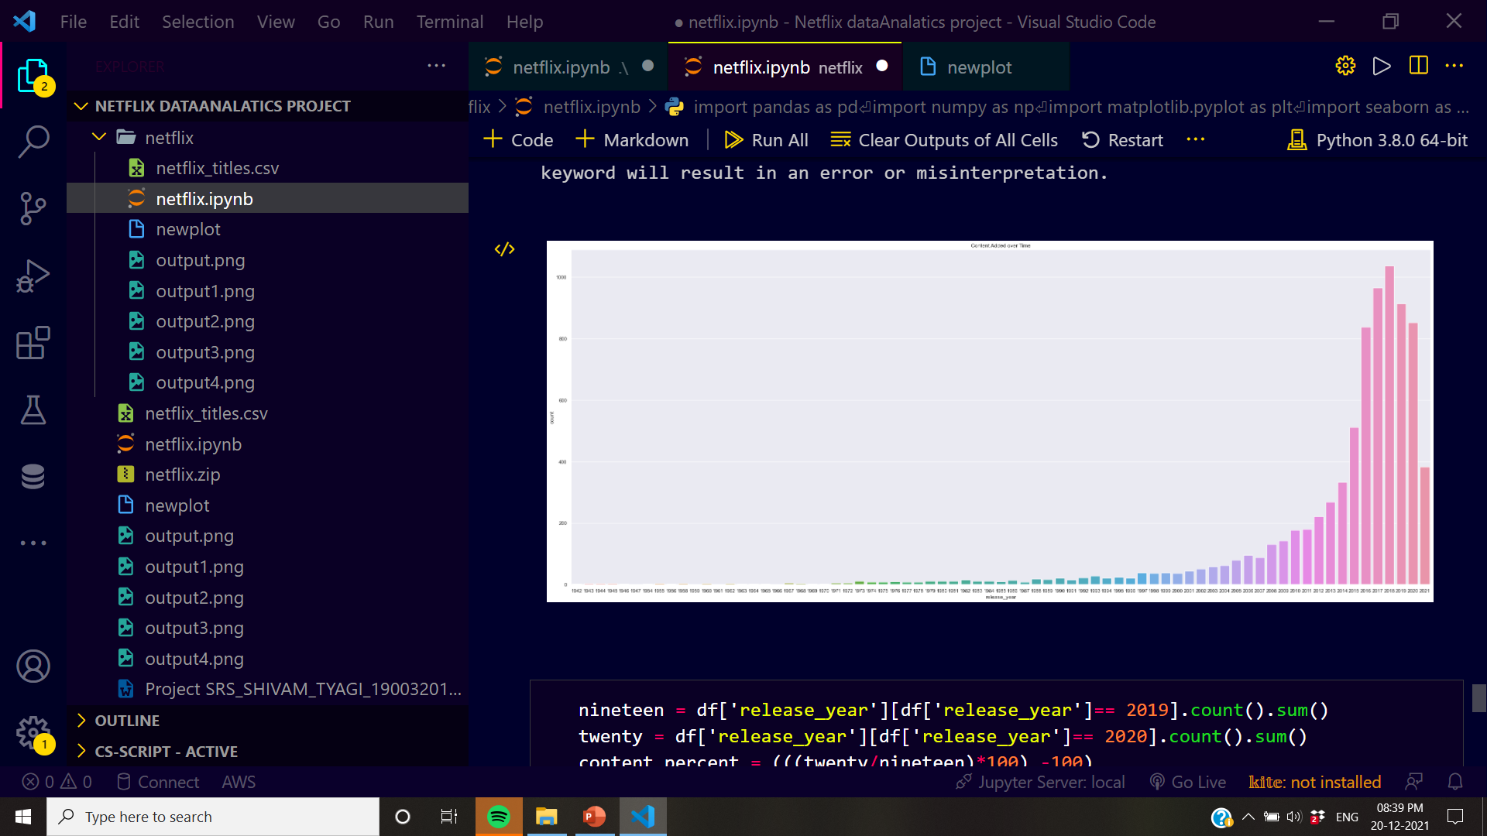
Screen.27

Slide 35
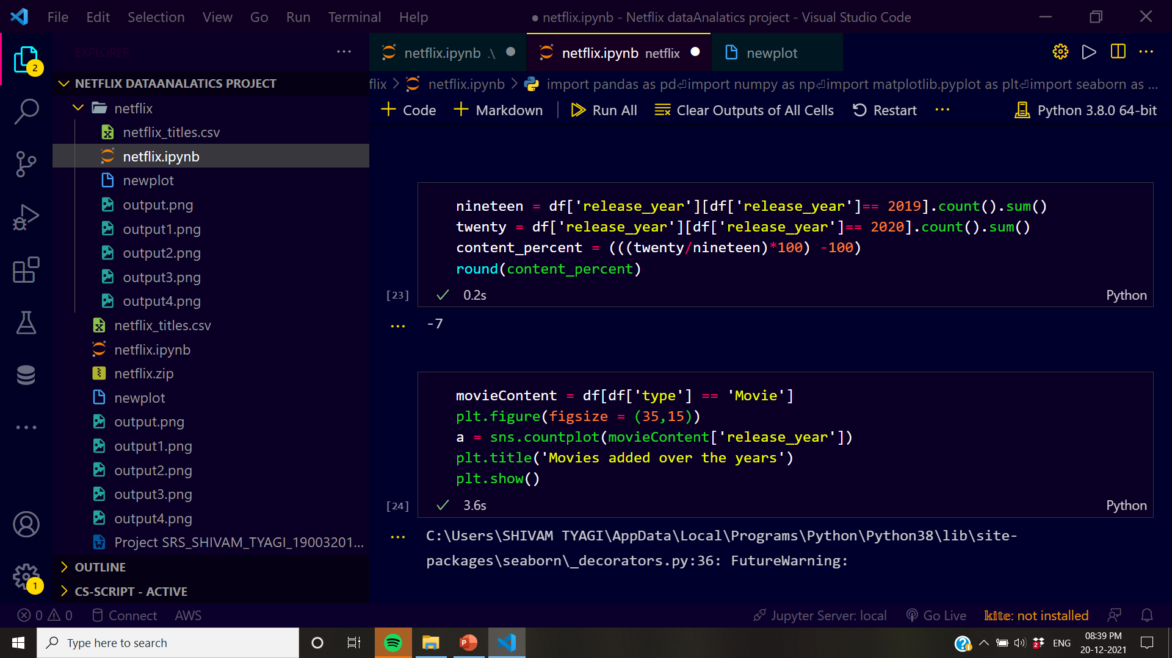
Screen.28

Slide 36
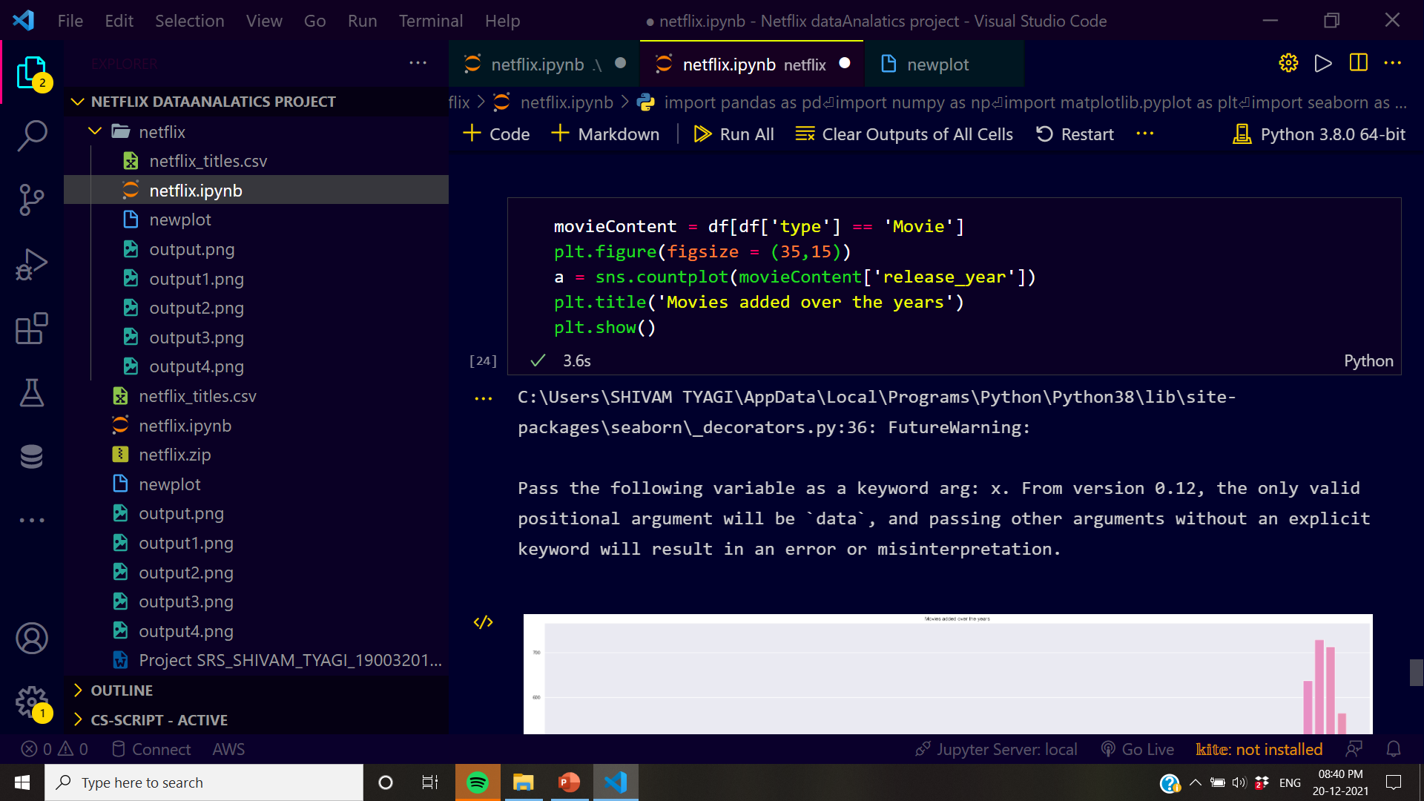
Screen.28

Slide 37
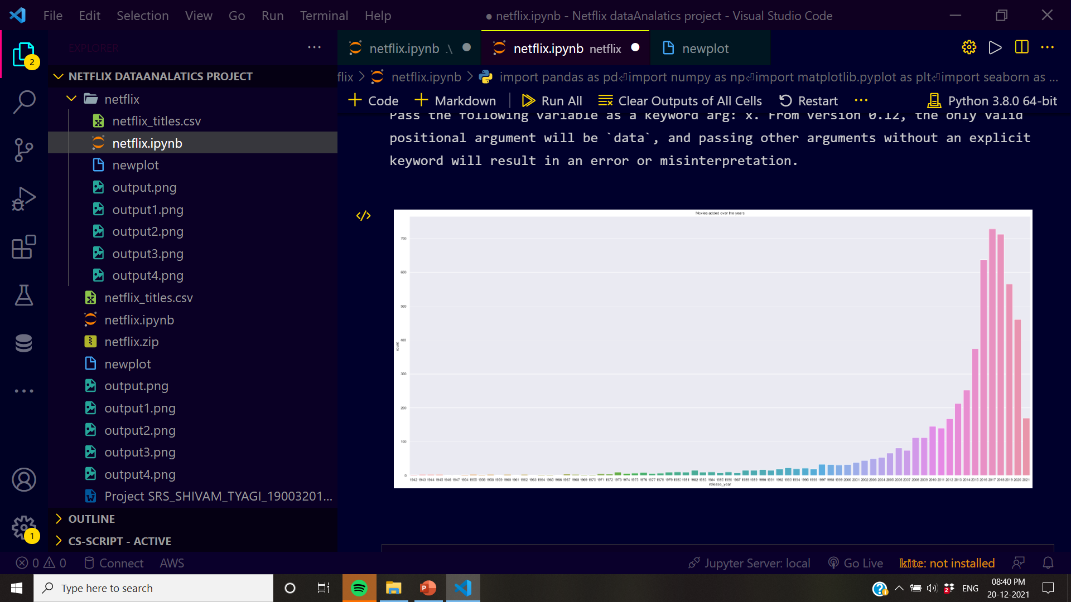
Screen.29

Slide 38
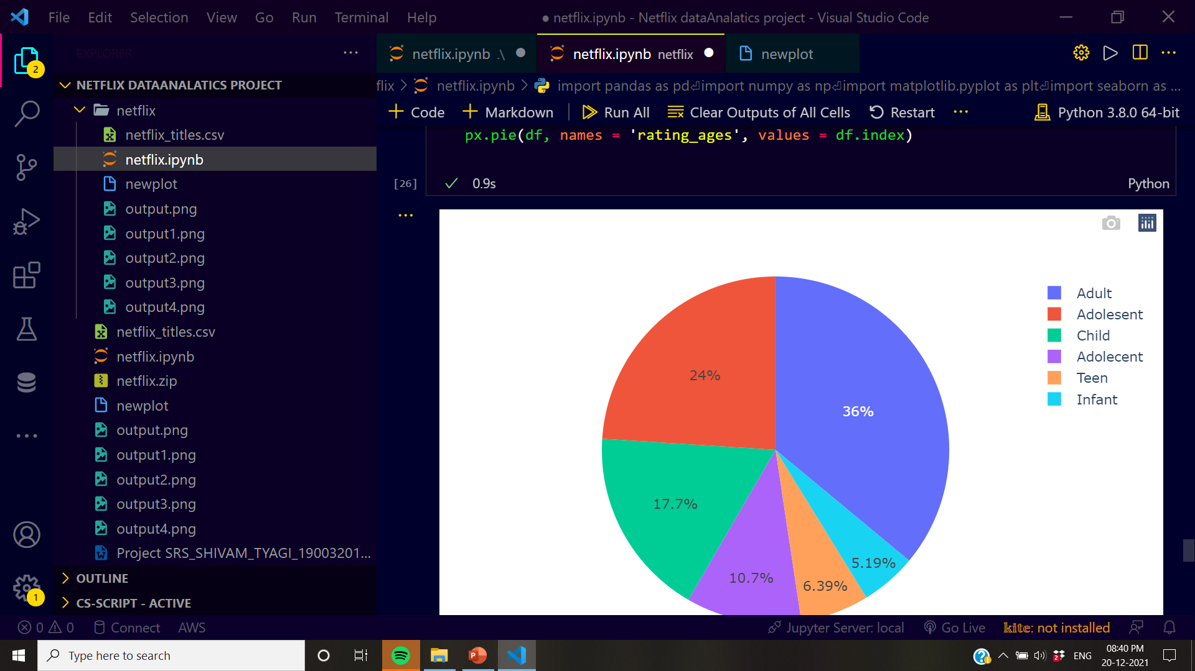
Screen.30

Slide 39
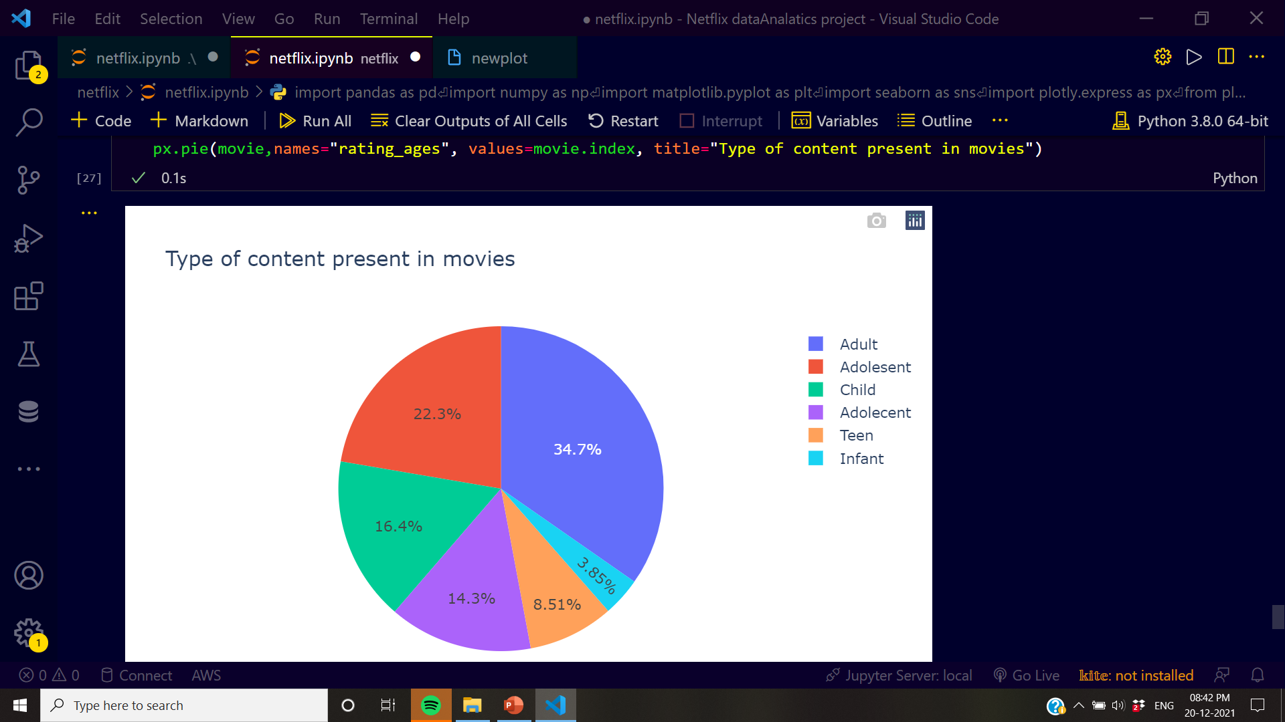
Screen.31

Slide 40
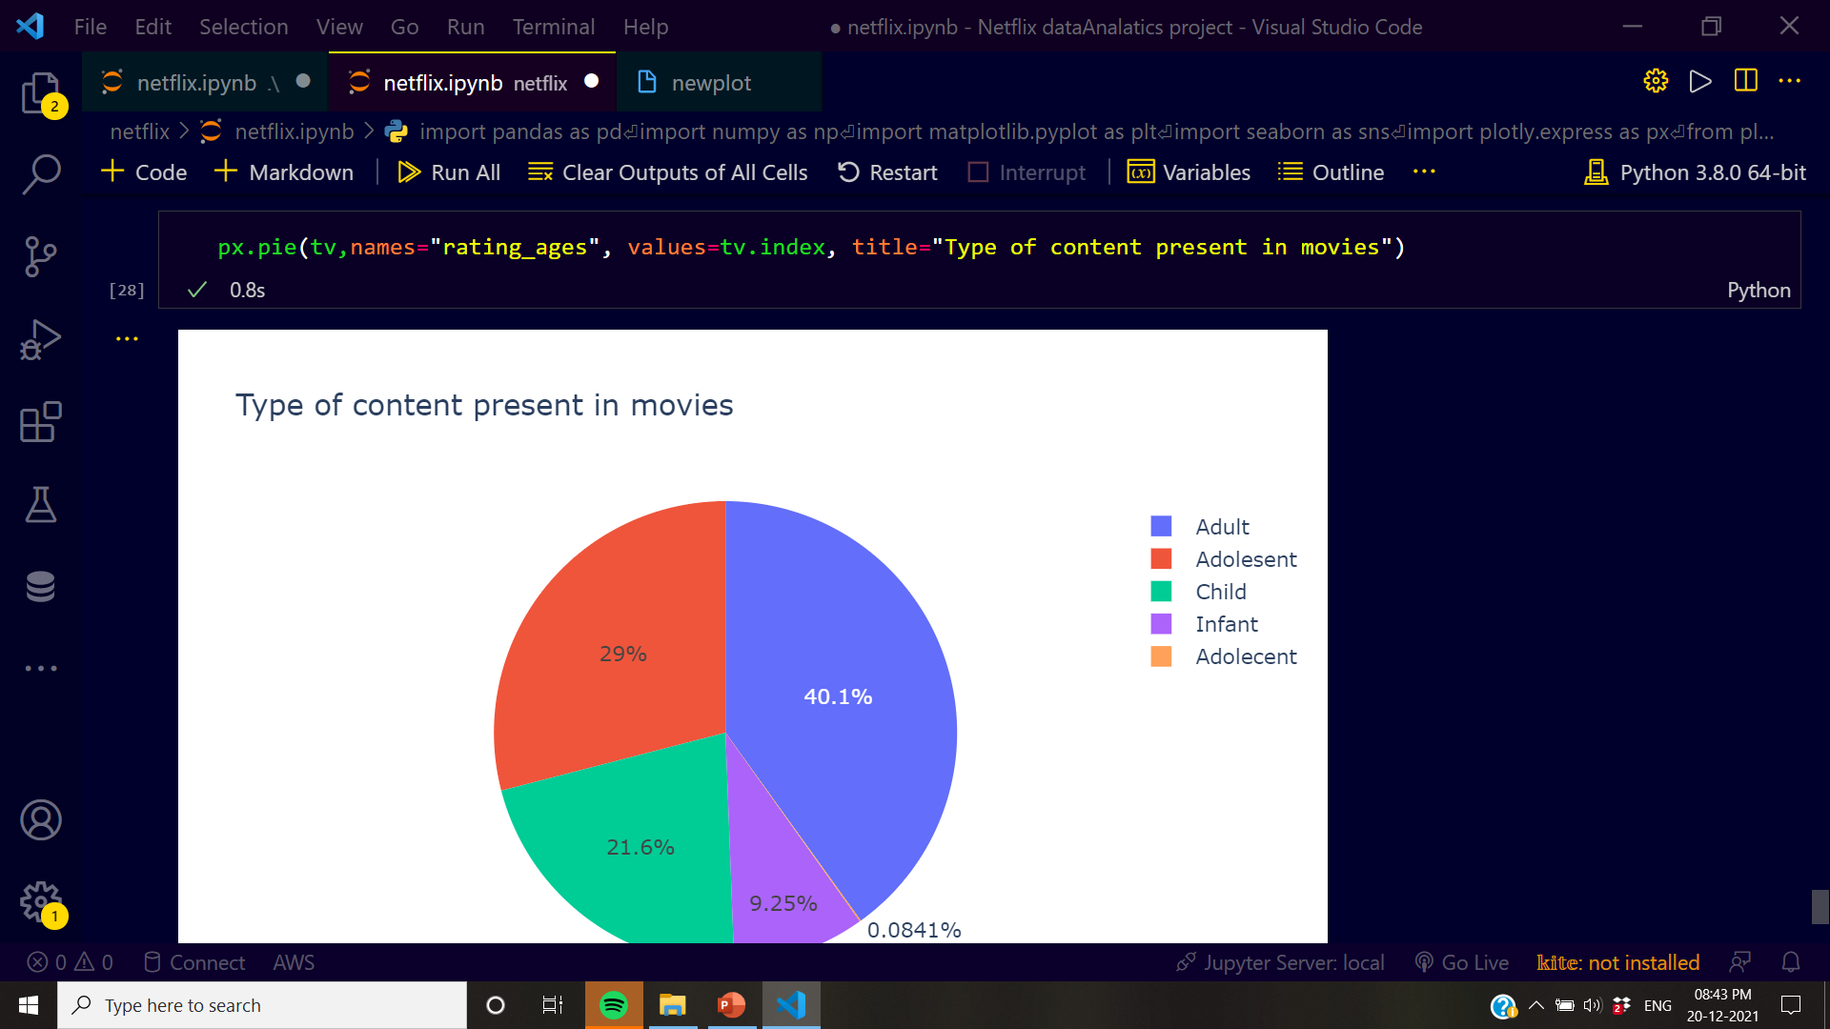
Screen.32

Slide 41
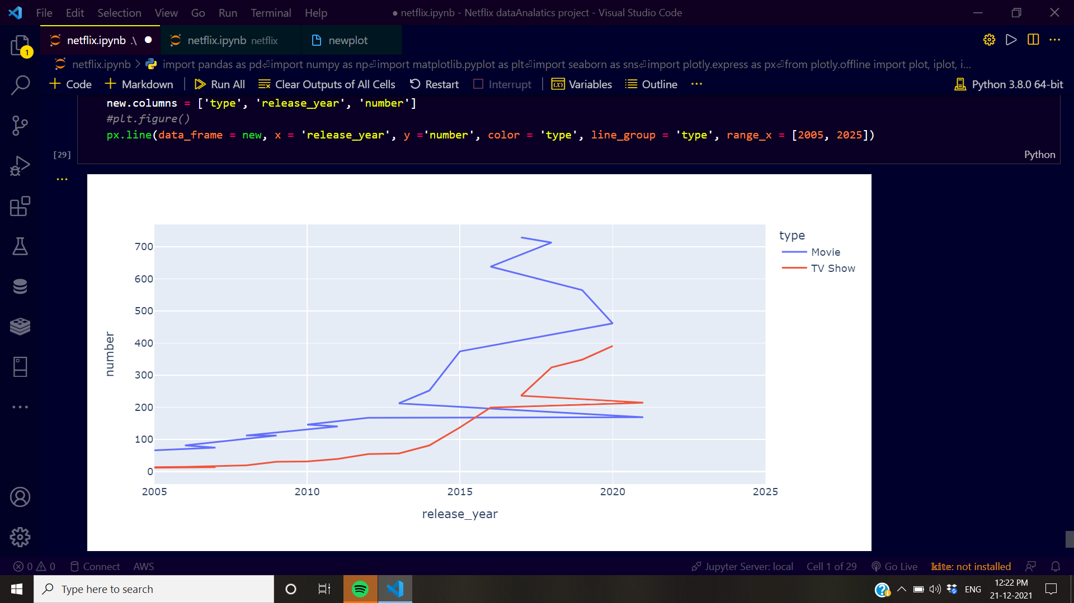
Screen.32

Slide 42
.
THANK YOU

